Slide 1
Computer Organization

Slide 2
Topics
The Computer Level Hierarchy
Structure & Function of Computer
The Von Neumann Model
Moore’s Law
Terminology

Slide 3
The Computer Level Hierarchy
Writing complex programs requires
  A “divide and conquer” approach, where each program module solves a smaller problem
Complex computer systems employ a similar technique through a series of virtual machine layers

Slide 4
Six
Level Computer
LEVEL 5
Problem Oriented Language Level
(High Language Level)
Translation(Compiler)
LEVEL 4
Assembly Language Level
Translation(Assembler)
LEVEL 3
Operating System Machine Level
Partial Interpretation
(Operating System)
LEVEL 2
Instruction Set Architecture Level
Interpretation (Microprogram) /
Direct Execution (Hardwired)
LEVEL 1
Micro Architecture Level
Hardware
LEVEL 0
Digital Logic Level

Slide 5
The Computer Level Hierarchy
Level 5: Problem Oriented (High-Level) Language Level
  Program execution and user interface level
  The level with which we are most familiar
  The level with which we interact when we write programs in languages such as C, Pascal, Lisp, and Java
Level 4: Assembly Language Level
  Acts upon assembly language produced from Level 5, as well as instructions programmed directly at this level
Level 3: Operating System Machine (System Software) Level
  Controls executing processes on the system
  Protects system resources
  Assembly language instructions often pass through Level 3 without modification

Slide 6
The Computer Level Hierarchy
Level 2: Instruction Set Architecture (ISA) Level
  Also known as the Machine Level
  Consists of instructions that are particular to the architecture of the machine
  Programs written in machine language need no compilers, interpreters, or assemblers

Slide 7
The Computer Level Hierarchy
Level 1: Control Level
  A control unit decodes and executes instructions and moves data through the system
  A collection of 8 to 32 registers form a local memory and a circuit called an ALU capable of performing simple arithmetic operations are present
  The registers are connected to the ALU to form a data path over which data flow
  On some machines the operation of the data path is controlled by a program called a microprogram – microprogrammed CU
    A microprogram is a program written in a low-level language that is implemented by the hardware
  On other machines the data path is controlled directly by hardware – hardwired CU
    Hardwired control units consist of hardware that directly executes machine instructions

Slide 8
The Computer Level Hierarchy
Level 0: Digital Logic Level
  Where find digital circuits (the chips)
  Digital circuits consist of gates and wires
    Each gate has one or more digital inputs and computes some simple function of the inputs such as AND or OR
  These components implement the mathematical logic of all other levels
  A small number of gates can be combined to form a 1-bit memory, 1-bit memories can be combined to form 16, 32, or 64 bit registers which can hold a single binary number

Slide 9
Structure & Function of Computer
At the most basic level, a computer is a device consisting of :
  A processor to interpret and execute programs
  A memory to store both data and programs
  A mechanism for transferring data to and from the outside world (Input/Output)
Structure is the way in which components relate to each other
Function is the operation of individual components as part of the structure

Slide 10
Structure - Top Level
Peripherals
Computer
Central
Processing
Unit
Main
Memory
Computer
Systems
Interconnection
Input
Output
Communication
lines

Slide 11
Structure - The CPU
CPU
Computer
Arithmetic
and
Login Unit
I/O
Registers
System
Bus
CPU
Internal CPU
Interconnection
Memory
Control
Unit

Slide 12
Structure - The Control Unit
Control Unit
CPU
Sequencing
Login
ALU
Internal
Bus
Control
Unit
Control Unit
Registers and
Decoders
Registers
Control
Memory

Slide 13
Computer Functions
Data processing
Data storage
Data movement
Control

Slide 14

Functional view

Slide 15

Operations (1) Data movement
Simply transferring data from one peripheral or communications line to another.

Slide 16
Operations (2) Storage
Data transferred from the external environment to computer storage (read) and vice versa (write).

Slide 17
Operation (3) Processing from/to storage

Slide 18
Operation (4)
Processing from storage to I/O

Slide 19
Basic Computer Model
The von Neumann Model

Slide 20
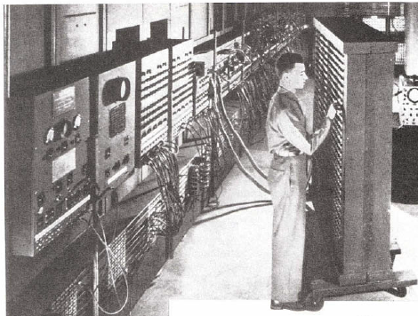
Why The Von Neumann Model ?
On the ENIAC, all programming was done at the digital logic level
Programming the computer involved moving plugs and wires
Configuring the ENIAC to solve a “simple” problem required many days labor by skilled technicians
A different hardware configuration was needed to solve every unique problem type

Slide 21
The von Neumann Model
The invention of stored program computers has been ascribed by a mathematician, John von Neumann
Stored-program computers have known as von Neumann Architecture systems

Slide 22
The von Neumann Model
Stored-program computers have the following characteristics:
  Three hardware systems:
    A central processing unit (CPU)
    A main memory system
    An I/O system
  Provides the capacity to carry out sequential instruction processing

Slide 23
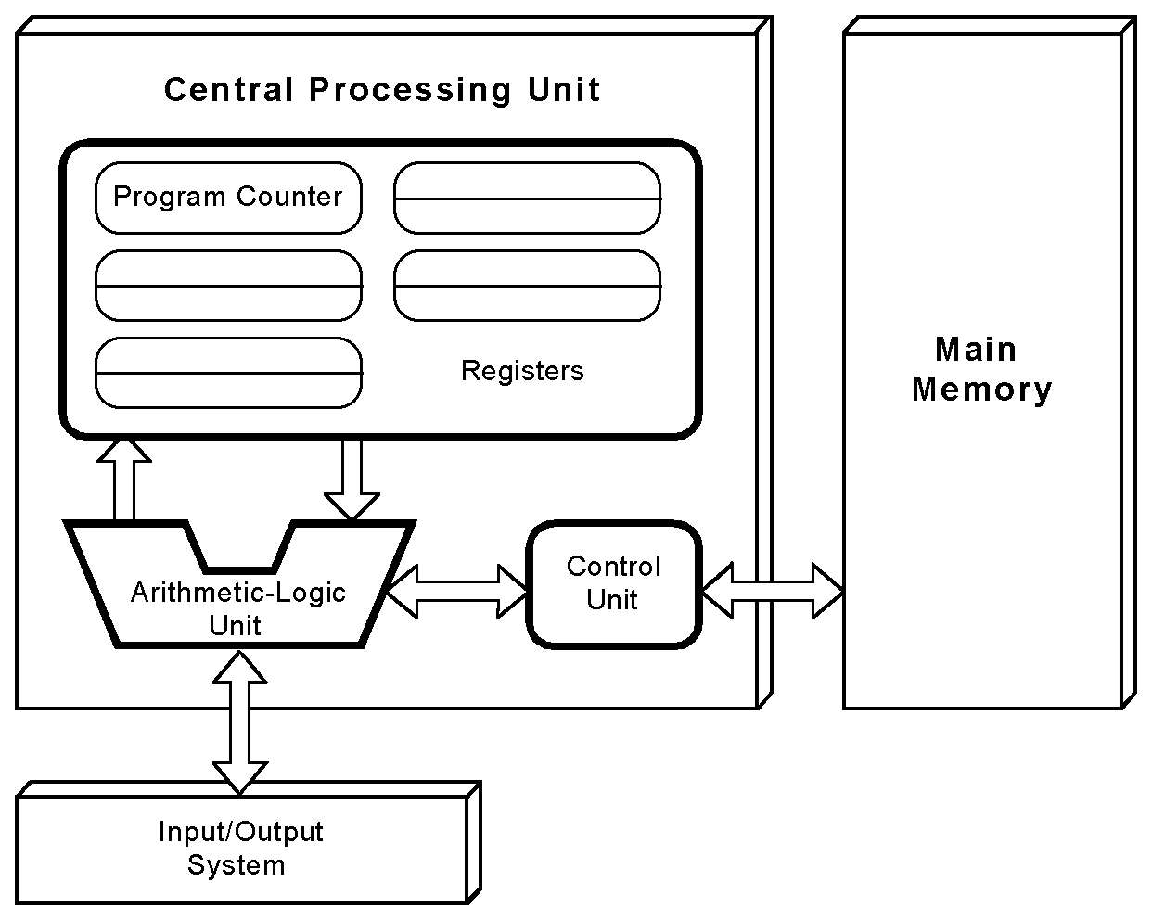
The von Neumann Model
Computers employ a fetch-decode-execute cycle to run programs

Slide 24
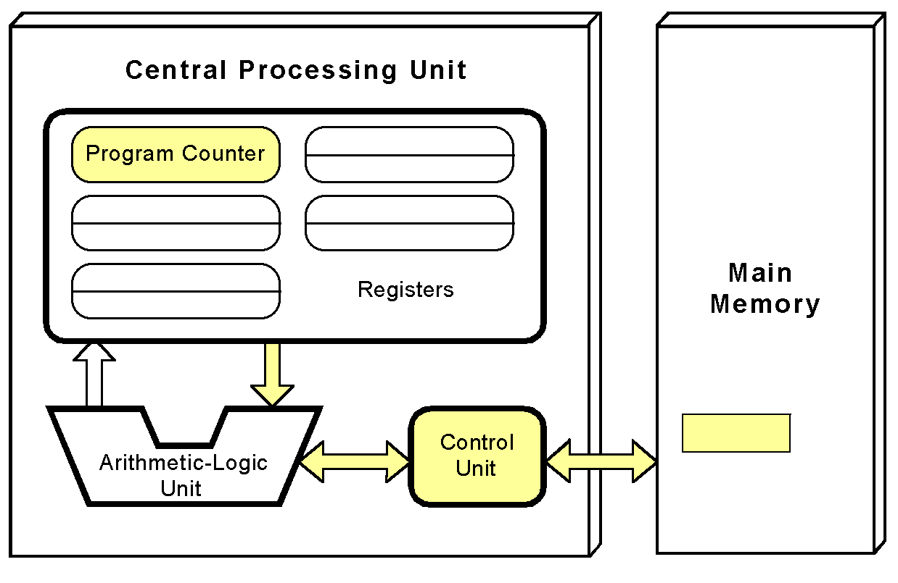
The von Neumann Model
The control unit fetches the next instruction from memory using the program counter to determine where the instruction is located

Slide 25
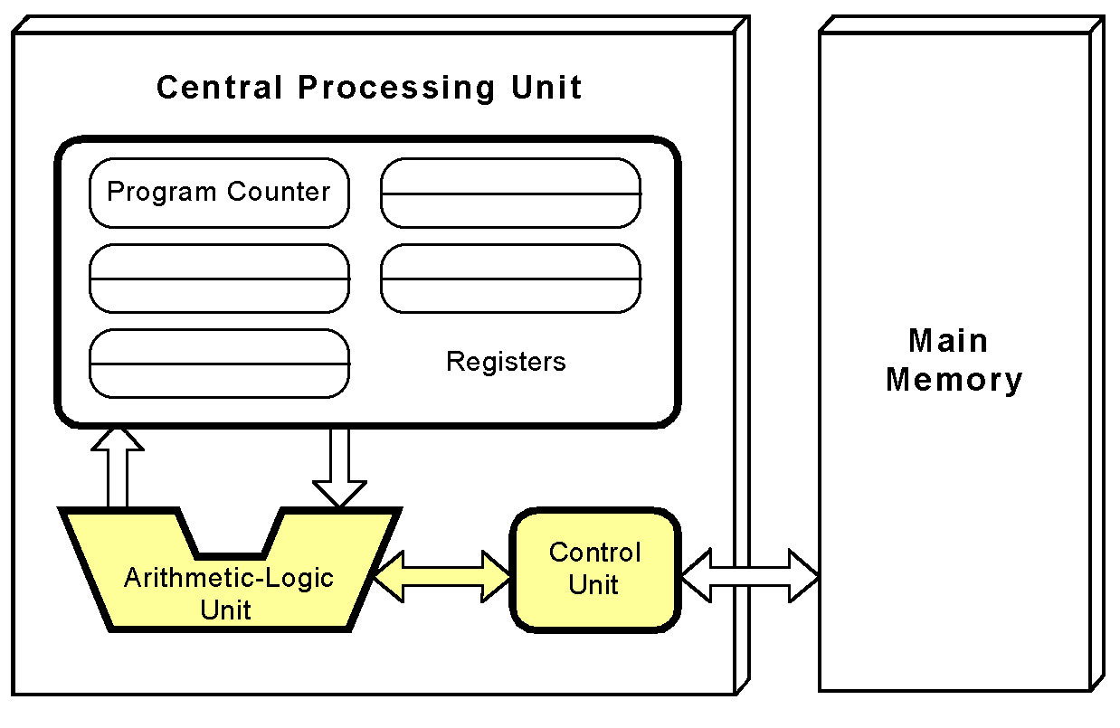
The von Neumann Model
The instruction is decoded into a language that the ALU can understand

Slide 26
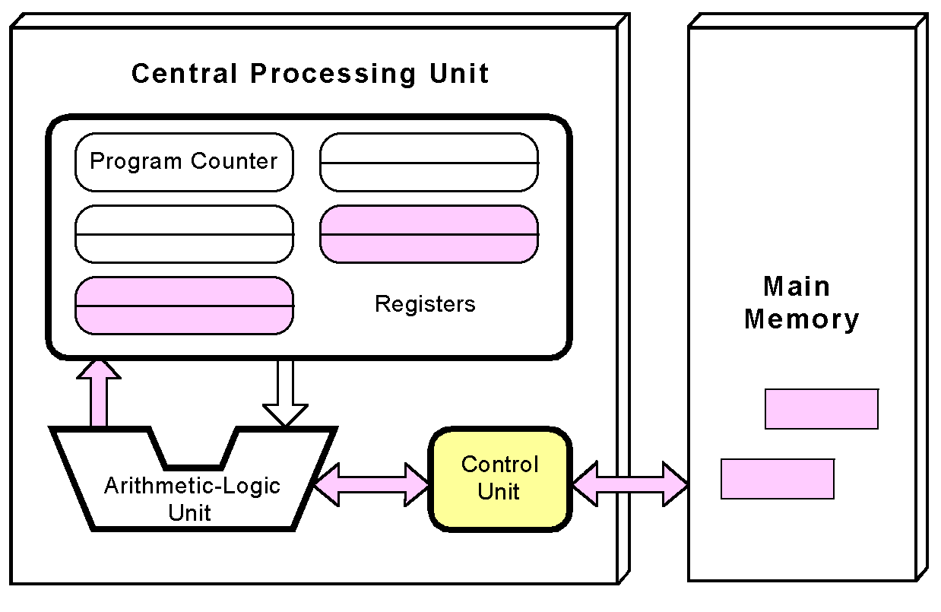
The von Neumann Model
Any data operands required to execute the instruction are fetched from memory and placed into registers within the CPU

Slide 27
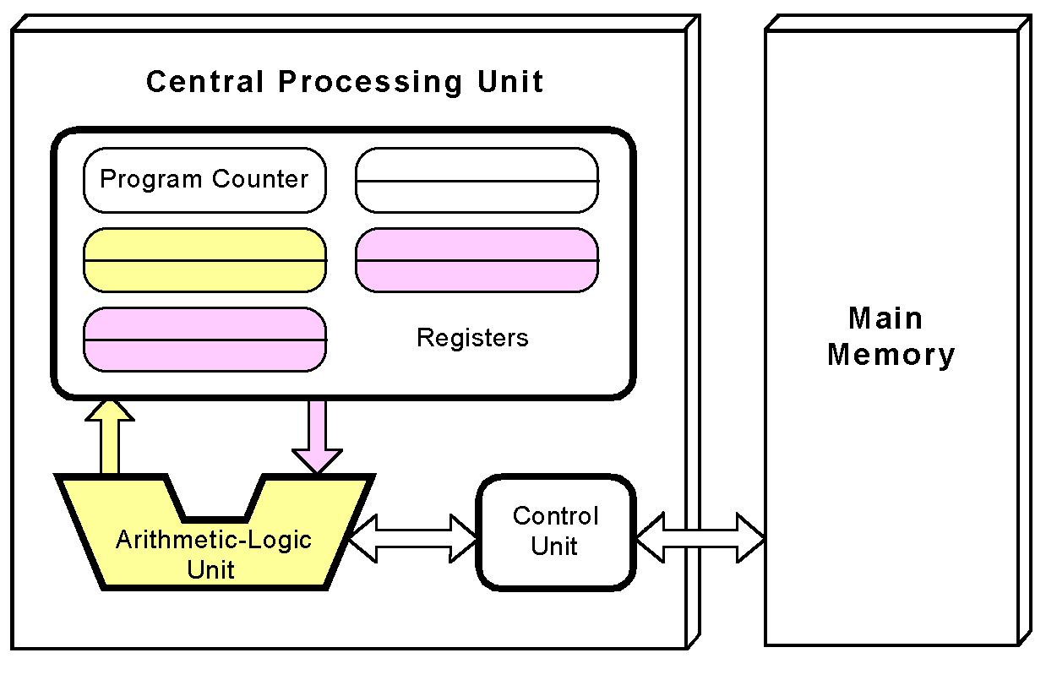
The von Neumann Model
The ALU executes the instruction and places results in registers or memory

Slide 28
The von Neumann Model
Used the system bus
  Data bus moves data from main memory to the CPU registers (and vice versa)
  Address bus holds the address of the data that the data bus is currently accessing
  Control bus carries the necessary control signals that specify how the information transfer is to take place

Slide 29
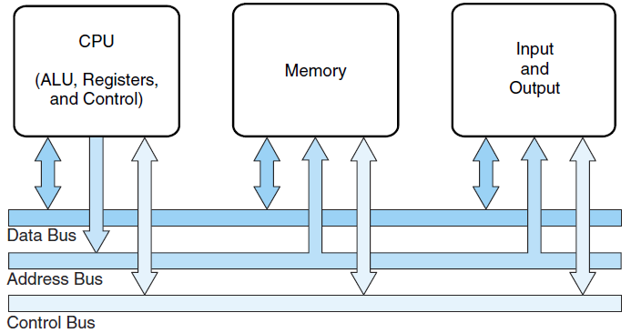
The von Neumann Model

Slide 30
The von Neumann Model
A single data path between the CPU and main memory
  This single path is known as the von Neumann bottleneck

Slide 31
Today’s-von Neumann Models
With many incremental improvements over the years:
  Adding specialized buses
    Programs and data stored in a slow-to-access storage medium, such as a HD, can be copied to a fast-access, volatile storage medium such as RAM prior to execution.
      This architecture called the system bus model.
        The data bus moves data from main memory to the CPU registers (and vice versa).
        The address bus holds the address of the data that the data bus is currently accessing.
        The control bus carries the necessary control signals that specify how the information transfer is to take place.
  Use of index registers addressing
  Floating-point units
  Cache memories
  Use of interrupts
  Asynchronous I/O
  Concept of Virtual Memory
  …

Slide 32
von Neumann Models
Sufficient?
  No, Computational power require departure from the classic von Neumann architecture

Slide 33
Non-von Neumann Models
Adding processors is one approach
  In the late 1960s, high-performance computer systems were equipped with dual processors to increase computational throughput
In the 1970s supercomputer systems were introduced with 32 processors
Supercomputers with 1,000 processors were built in the 1980s
In 1999, IBM announced its Blue Gene system containing over 1 million processors

Slide 34
Non-von Neumann Models
Parallel processing is only one method of providing increased computational power
DNA computers, quantum computers and dataflow systems
  May be the basis for the next generation of computers

Slide 35
Moore’s Law
Rapidly changing field:
  Vacuum tube -> Transistor -> IC -> VLSI
  Memory capacity
  Processor speed (due to advances in technology and hardware organization)

Slide 36
Moore’s Law
In 1965 by Gordon Moore, Intel founder
  “The density of transistors in an integrated circuit will double every year.”
Contemporary version:
  “The density of silicon chips doubles every 18 months.”
Notes:
Contemporary version is the current trend…

Slide 37
Terminology

Slide 38
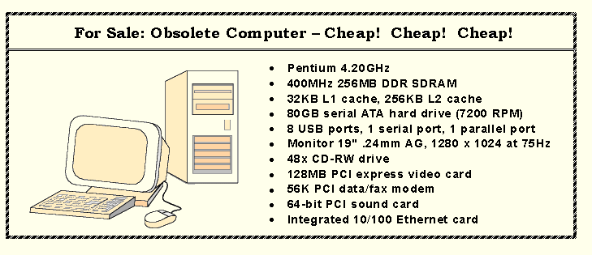
An Example System
Consider this advertisement:
MHz??
MB??
L1 Cache??
PCI??
USB??
What does it all mean??

Slide 39
Summary
Components of Computer
The Computer Level Hierarchy
Structure & Function of Computer
Terminology

Slide 40
Next
ISA

Slide 41
Computer History
Generation Zero:
  Mechanical Calculating Machines (1642 - 1945)
  Calculating Clock - Wilhelm Schickard (1592 - 1635).
  Pascaline - Blaise Pascal (1623 - 1662).
  Difference Engine - Charles Babbage (1791 - 1871), also designed but never built the Analytical Engine.
  Punched card tabulating machines - Herman Hollerith (1860 - 1929).
The First Generation:
  Vacuum Tube Computers (1945 - 1953)
  Electronic Numerical Integrator and Computer (ENIAC) by John Mauchly and J. Presper Eckertat the University of Pennsylvania, 1946
  The IBM 650 first mass-produced computer. (1955).
The Second Generation:
  Transistorized Computers (1954 - 1965)
  IBM 7094 (scientific) and 1401 (business)
  Digital Equipment Corporation (DEC) PDP-1
  Univac 1100
  Control Data Corporation 1604.
  . . . and many others.

Slide 42
Computer History
The Third Generation:
  Integrated Circuit Computers (1965 - 1980)
  IBM 360
  DEC PDP-8 and PDP-11
  Cray-1 supercomputer
  . . . and many others.
  By this time, IBM had gained overwhelming dominance in the industry.
    Computer manufacturers of this era were characterized as IBM and the BUNCH (Burroughs, Unisys, NCR, Control Data, and Honeywell).
The Fourth Generation:
  VLSI Computers (1980 - ????)
  Very large scale integrated circuits (VLSI) have more than 10,000 components per chip.
  Enabled the creation of microprocessors.
  The first was the 4-bit Intel 4004.
  Later versions, such as the 8080, 8086, and 8088 spawned the idea of “personal computing.”

Slide 43
An Example System
Measures of capacity and speed:
Hertz = clock cycles per second (frequency)
  1MHz = 1,000,000Hz
  Processor speeds are measured in MHz or GHz.
Byte = a unit of storage
  1KB = 2¹⁰ = 1024 Bytes
  1MB = 2²⁰ = 1,048,576 Bytes
  Main memory (RAM) is measured in MB
  Disk storage is measured in GB for small systems, TB for large systems.
  Kilo- (K) = 1 thousand = 10³ and 2¹⁰
  Mega- (M) = 1 million = 10⁶ and 2²⁰
  Giga- (G) = 1 billion = 10⁹ and 2³⁰
  Tera- (T) = 1 trillion = 10¹² and 2⁴⁰
  Peta- (P) = 1 quadrillion = 10¹⁵ and 2⁵⁰
  ?

Slide 44
An Example System
Measures of time and space:
Millisecond = 1 thousandth of a second
  Hard disk drive access times are often 10 to 20 milliseconds.
Nanosecond = 1 billionth of a second
  Main memory access times are often 50 to 70 nanoseconds.
Micron (micrometer) = 1 millionth of a meter
  Circuits on computer chips are measured in microns.
  Milli- (m) = 1 thousandth = 10⁻³
  Micro- (μ) = 1 millionth = 10⁻⁶
  Nano- (n) = 1 billionth = 10⁻⁹
  Pico- (p) = 1 trillionth = 10⁻¹²
  Femto- (f) = 1 quadrillionth = 10⁻¹⁵

Slide 45
An Example System
Cycle time is the reciprocal of clock frequency.
A bus operating at 133MHz has a cycle time of 7.52 nanoseconds:
133,000,000 cycles/second = 7.52ns/cycle
Now back to the advertisement ...

Slide 46
An Example System
The microprocessor is the “brain” of the system. It executes program instructions. This one is a Pentium (Intel) running at 4.20GHz.
A system bus moves data within the computer. The faster the bus the better. This one runs at 400MHz.

Slide 47
An Example System
Large main memory capacity means you can run larger programs with greater speed than computers having small memories.
RAM - Random Access Memory
  Time to access contents is independent of its location.
Cache is a type of temporary memory
  that can be accessed faster than RAM.

Slide 48
An Example System
This system has 256MB of (fast) Double Data Rate (DDR) Synchronous Dynamic RAM (SDRAM) . . .
… and two levels of cache memory, the level 1 (L1) cache is smaller and (probably) faster than the L2 cache. Note that these cache sizes are measured in KB.

Slide 49
An Example System
Hard disk capacity determines the amount of data and size of programs you can store.
This one can store 80GB. 7200 RPM is the rotational speed of the disk. Generally, the faster a disk rotates, the faster it can deliver data to RAM. (There are many other factors involved.)

Slide 50
An Example System
ATA stands for advanced technology attachment, which describes how the hard disk interfaces with (or connects to) other system components.
A CD can store about 650MB of data. This drive supports rewritable CDs, CD-RW, that can be written to many times.. 48x describes its speed.

Slide 51
An Example System
Ports allow movement of data between a system and its external devices.
This system has ten ports.

Slide 52
An Example System
Serial ports send data as a series of pulses along one or two data lines.
Parallel ports send data as a single pulse along at least eight data lines.
USB, Universal Serial Bus, is an intelligent serial interface that is self-configuring. (It supports “plug and play.”)

Slide 53
An Example System
The number of times per second that the image on a monitor is repainted is its refresh rate. The dot pitch of a monitor tells us how clear the image is.
This one has a dot pitch of 0.24mm and a refresh rate of 75Hz.
The video card contains memory and programs that support the monitor.

Slide 54
An Example System
System buses can be augmented by dedicated I/O buses. PCI, peripheral component interface, is one such bus.
This system has three PCI devices: a video card, a sound card, and a data/fax modem.

